Slide 1

User manual for students for AIIMS LMS
https://saral.aiims.edu/

Slide 2
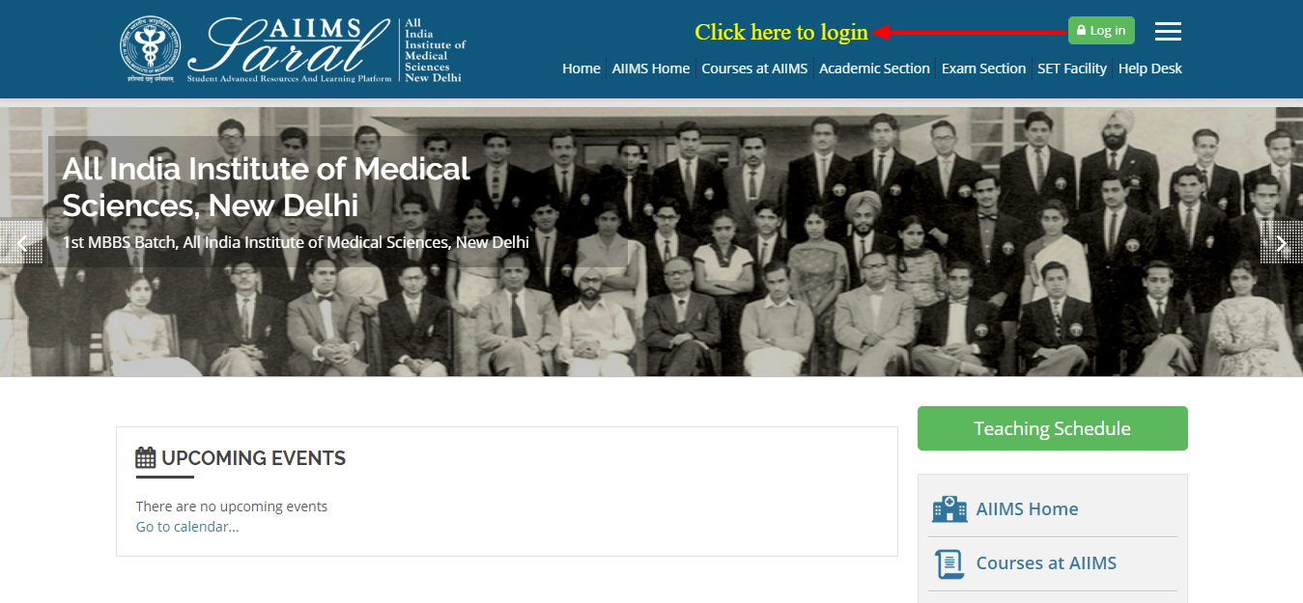
On the home page, upcoming events and the teaching schedule can be accessed without login.
Home Page/Login Page

Slide 3
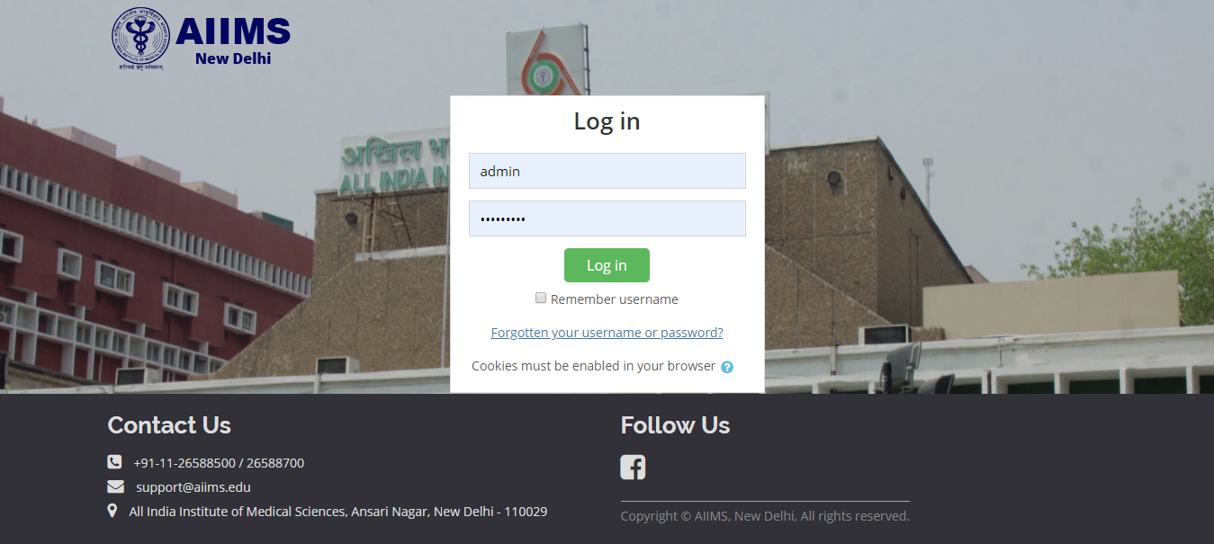
Enter the username/email address and password to access user-specific content. If you have forgotten your password, click on the link on this page
Login Page

Slide 4
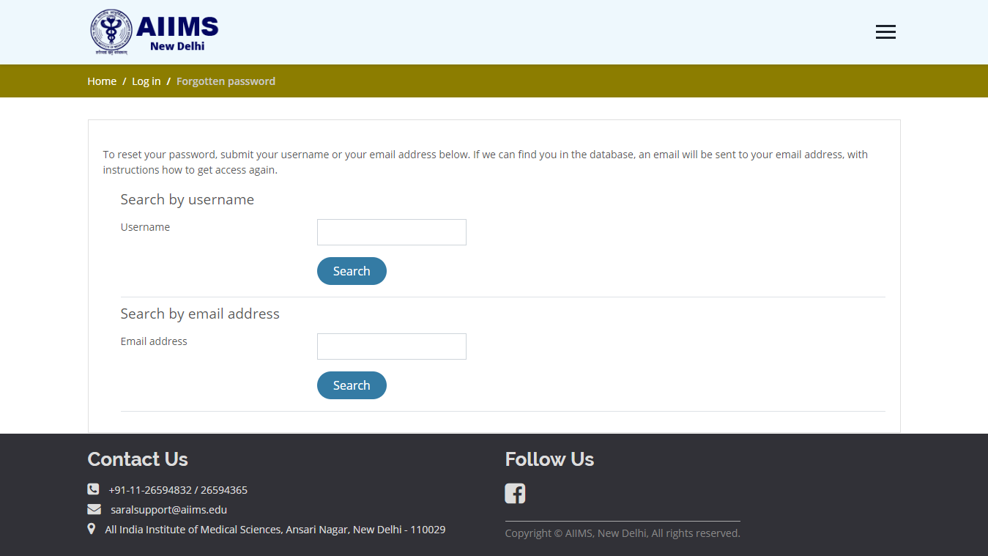
Password retrieval
To reset your password, please enter your username or email addressed used to create the SARAL account in the appropriate box and click the 'search' button. You will receive an email with further instructions on how to proceed with resetting your password.

Slide 5
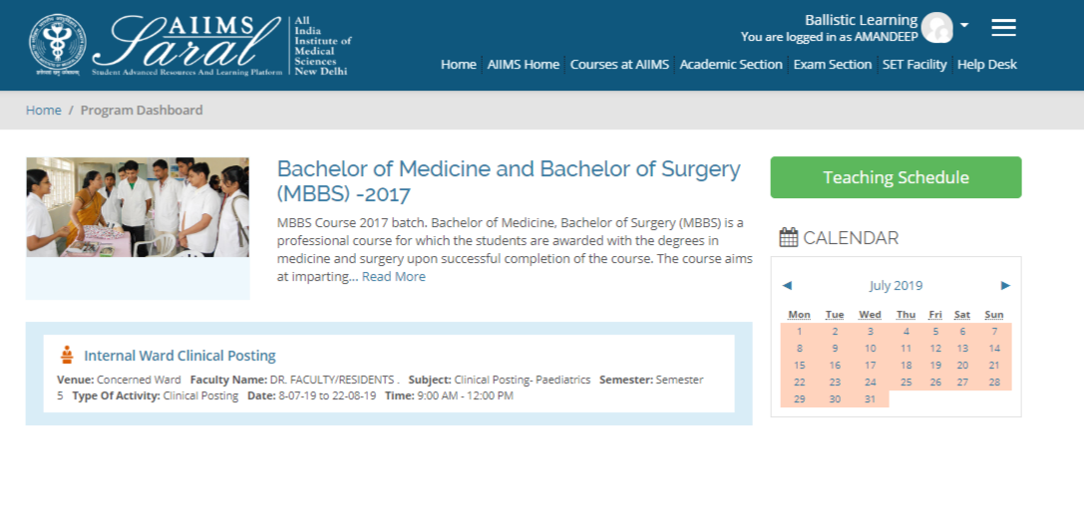
Once logged in, from the home page, students can see details of their course and a to-do list of the next 6 upcoming sessions of their course.
Student dashboard- after login

Slide 6
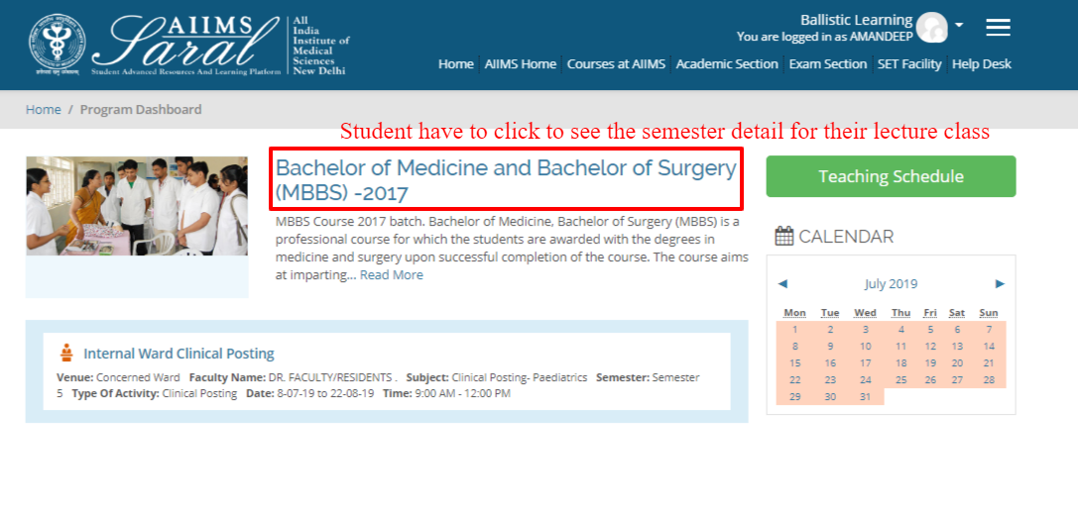
Course details can be accessed after clicking on the course name
Course details

Slide 7
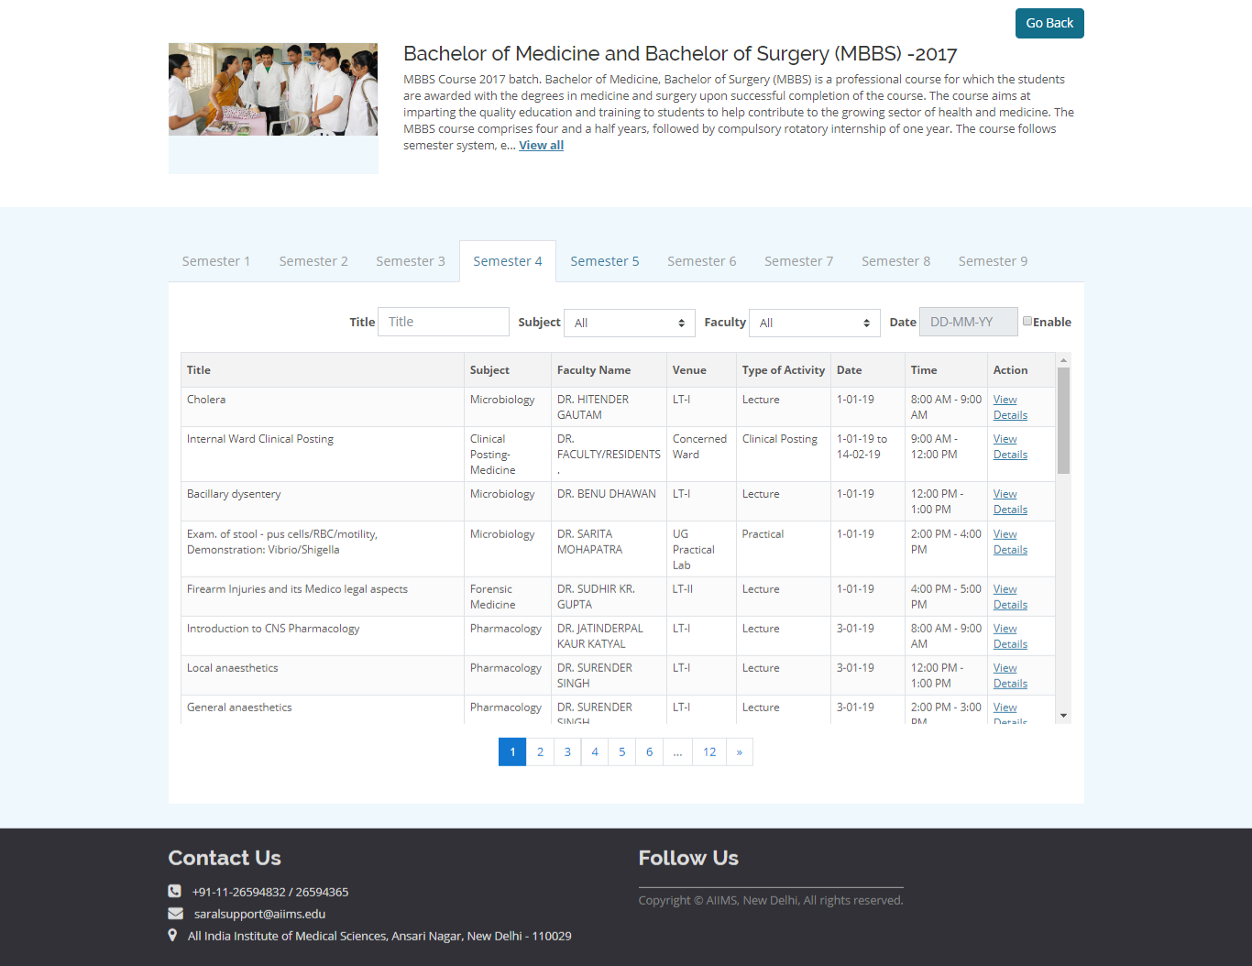
Details of the course content can be seen semester wise, date wise, or topic wise.
Course details

Slide 8
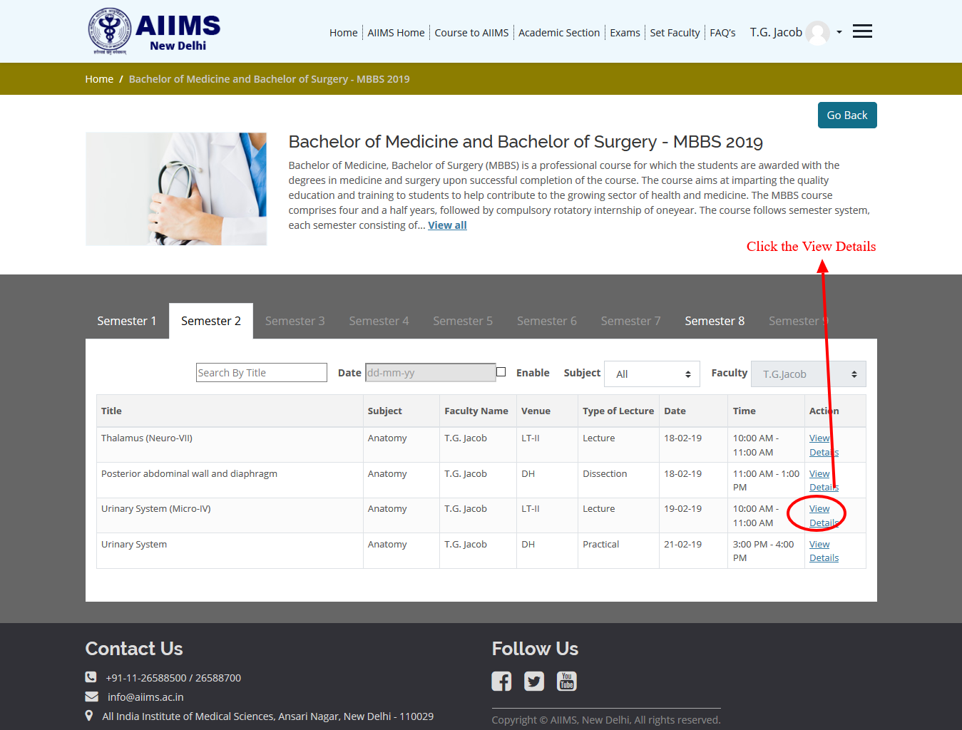
At the end of each event, clicking on the view details button will display any content that may have been uploaded by the teacher.
Event details

Slide 9
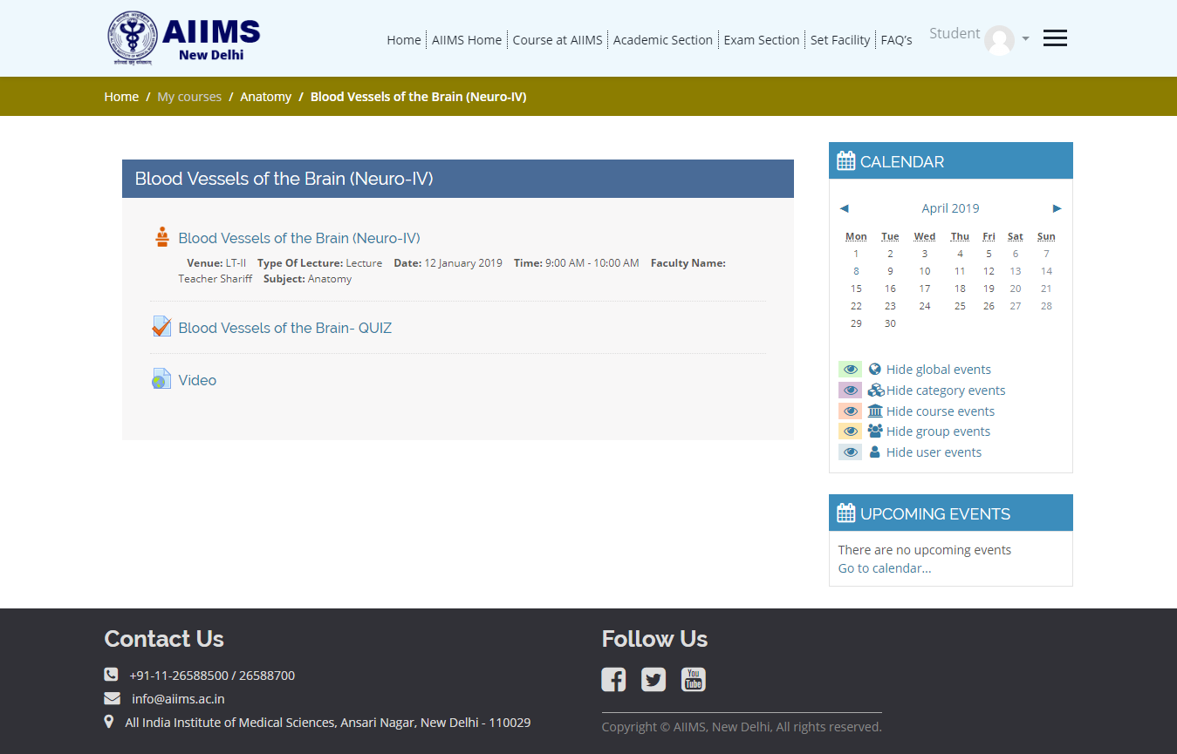
Event details may include exercises, quiz, discussion forums
Event details

Slide 10
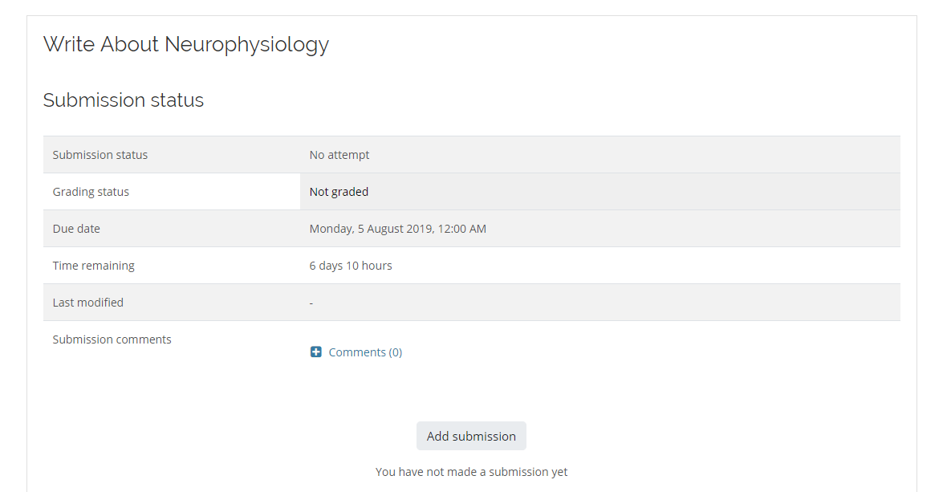
Click on the marked activity to take part in the assignment
How to perform an assignment activity

Slide 11
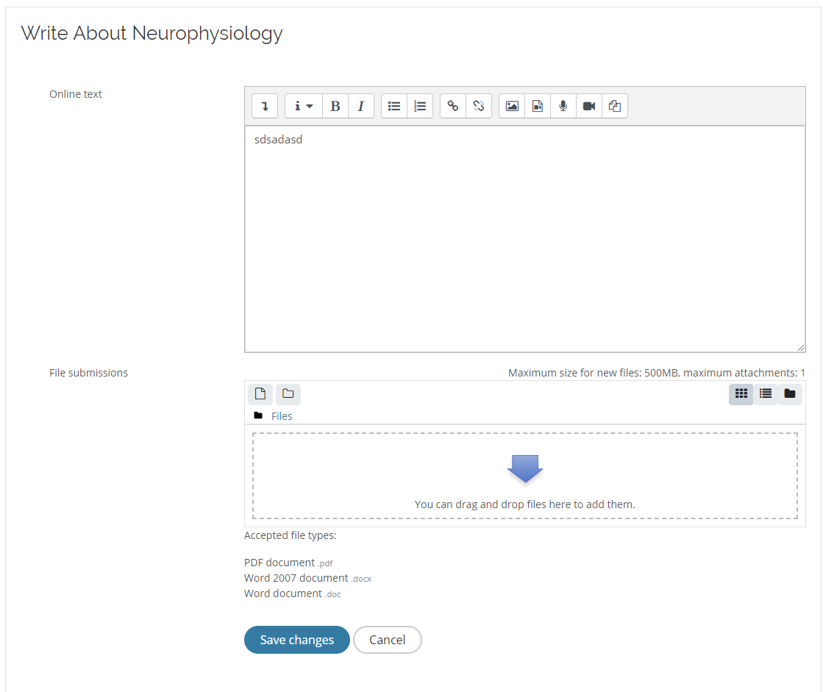
Add Online Text or submit a File
How to perform an assignment activity

Slide 12
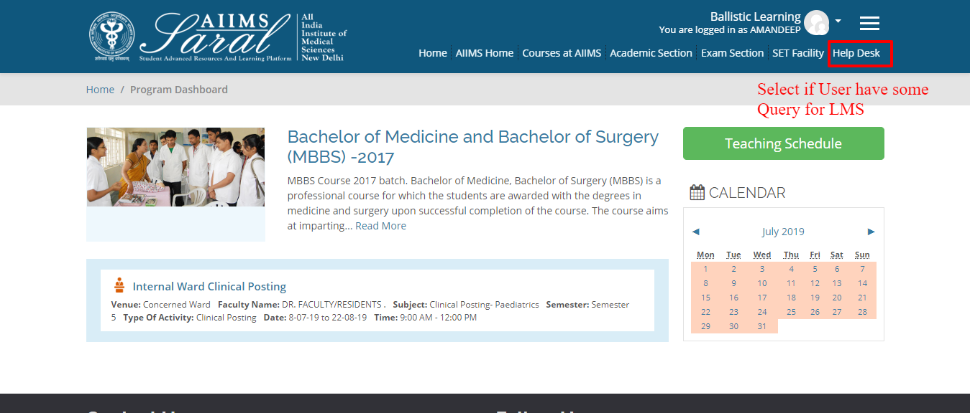
Help Desk
The Help Desk button on the top tab can be used to contact the SARAL administrator.

Slide 13
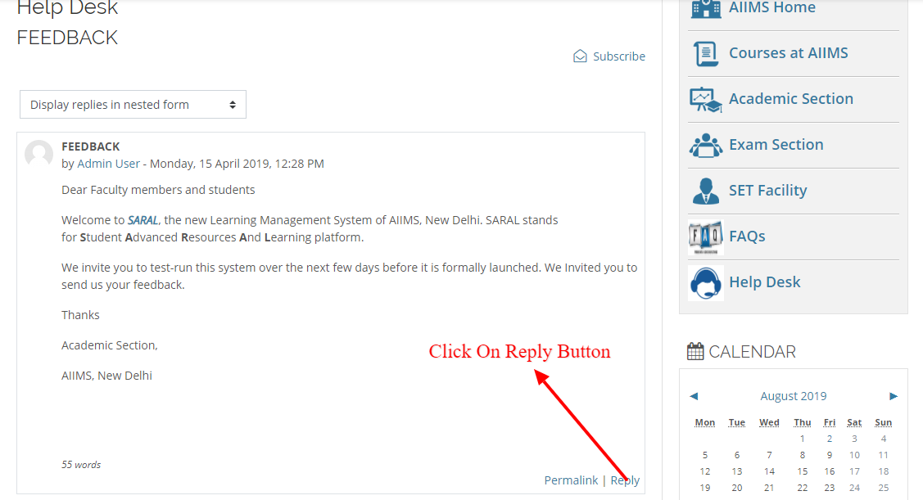
Current topics of discussion will be visible. Click on the ‘Reply’ button to contribute to the topic or raise a query.
Help Desk

Slide 14
Thank You

